Slide 1
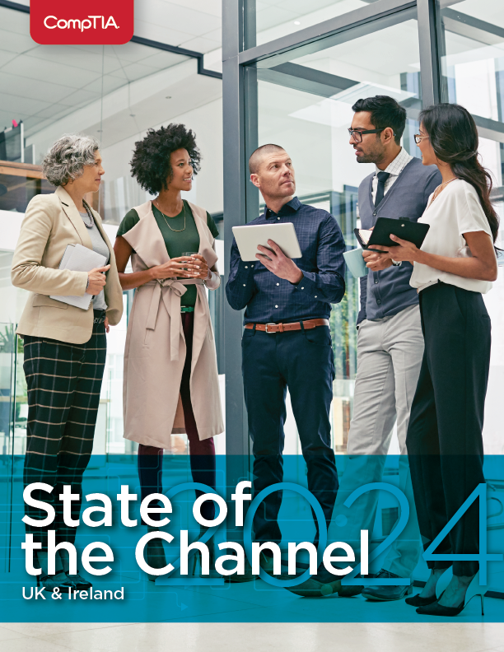
State of the Channel 2024
UK & Ireland

Slide 2
Key State of the Channel Stats
$1.5 trillion
Estimated spending on IT services globally in 2024, an 8.7% growth rate year-over-year to place as top segment of technology spending for the first time.
(Source: Gartner, January 2024 projection)
58%
of UK & Ireland channel firms say their business is in better shape today than it was two years ago
47%
of UK & Ireland channel firms say competition and pricing pressure concern them most as top inhibitors to revenue growth and profitability
53%
of UK & Ireland channel firms say they plan to sell generative AI-based solutions to customers in 2024
49%
of UK & Ireland channel firms cited training and certification as the main remedy for improving business skills
33%
of UK & Ireland channel firms say they participate in zero to four partner programs today
40%
of UK & Ireland channel firms escribe their company as “expert” in terms of general business acumen

Slide 3
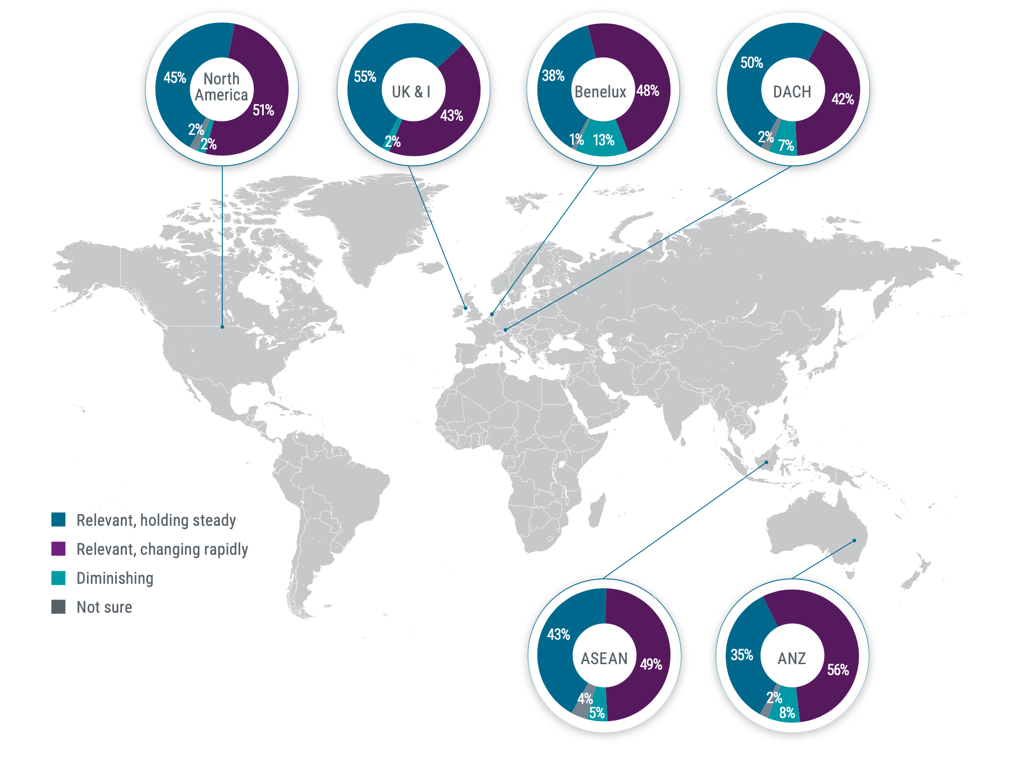
Global Channel Outlook
Source: CompTIA 2024 State of the Channel survey | n=1042 international respondents

Slide 4
Top Priorities in Maintaining a Relevant and Future-Oriented IT Channel
 | Australia & New Zealand | Benelux | ASEAN | UK & Ireland | DACH | North America
Top Positive Opportunity | Availability of generative AI tools & solutions | Availability of generative AI tools & solutions | Availability of generative AI tools & solutions | Technology’s growing complexity creates demand for expertise | Technology’s growing complexity creates demand for expertise | Technology’s growing complexity creates demand for expertise
Top Negative Development | External factors (i.e., global economy, inflation, interest rates) | External factors (i.e., global economy, inflation, interest rates) | Competition from online marketplaces & non-traditional players (i.e. prof services firms) | Competition from online marketplaces & non-traditional players (i.e. prof services firms) | External factors (i.e., global economy, inflation, interest rates) | External factors (i.e., global economy, inflation, interest rates)
Channel practitioners will fill their to-do list with items ranging from how to embrace new technologies like AI; handle new types of competition and market changes; capitalize on new and more sophisticated services opportunities; optimize and improve internal business functions and better serve customers and the workforce.
Source: CompTIA 2024 State of the Channel survey | n=1042 international respondents

Slide 5
How Channel Firms Describe Their Primary Business
In many ways, the channel ecosystem features two main camps filled with a variety of camper types. On one side sit those firms with a more traditional reseller heritage: Mostly stable, product-oriented SMB businesses with expertise in technology infrastructure work. The other camp includes newer entrants, those focused more closely on cloud-, digital- and services-based business models that aren’t as product-centric. Across these groups, however, you find abundant individual diversity, from referral-based providers to pure consultants to vertical specialists and beyond. And while some of these business types are more ascendant and high growth than others, each is carving out a space in the landscape.
Seller of Tech Products
23%
Seller of Business Solutions Featuring Tech
Seller of Tech Services
47%
30%
Source: CompTIA 2024 State of the Channel survey | n=129 UK&I respondents
Notes:
This definition is from 10 years ago. Much of it is applicable, right?

Slide 6
State of the IT Channel
Factors Contributing to Healthy IT Channel
2024
52%
Complexity of tech creating demand
52%
Adoption of generative AI tools
2%
Relevant, holding steady
51%
2023
Demand for cybersecurity services
Relevant, changing rapidly
Diminishing/Unsure
44%
Adoption of cloud computing
2021
36%
Demand for managed services
36%
Expanding channel business models
Source: CompTIA 2024 State of the Channel survey | 2024: n=129 UK&I respondents
2023: n=124 UK&I respondents
2021: n=125 UK respondents

Slide 7
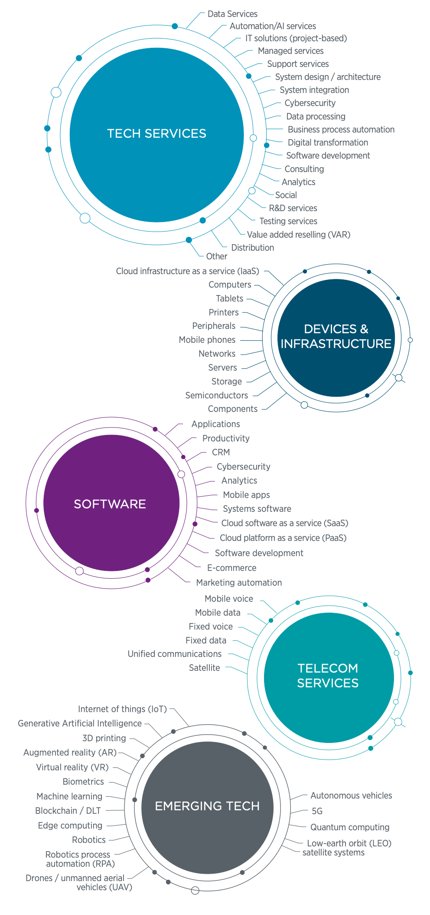
Overview of the IT Channel Ecosystem
The age-old question, ”what is the size of the IT channel” remains a fixture in many industry circles. It’s a far trickier one to answer than one might think. Immediately, the question requires clarification since the channel represents a varied ecosystem of firm types that aren’t necessarily easily grouped. So, is the intent to size all indirect channels, inclusive of distributors, retailers, online marketplaces, and other non- traditional players? Or is the focus on a subset of the market that can be characterized as traditional channel partners, such as VARs, MSPs, solution providers, tech consultants and related? What about hybrid models that feature facets of both indirect and direct selling? Or influencers that do not capture revenue, but may have sway over customer purchasing decisions (think accounting firms that direct their clients to a particular accounting software)? The historical rule of thumb for indirect channel sizing was approximately 75% of tech spend fed through it. That percentage is both difficult to validate and likely always a bit more anecdotal than precision factual.
According to CompTIA’s State of the Channel 2024, respondents settled on a weighted-average result of 57%, with estimates spanning 25% to 75%. This approximates the sales volume and/or influence of indirect channels applied to the technology categories in the accompanying graphic. The 57%, which is lower than the old rule of thumb number, likely reflects a shift toward direct sales advanced by the growth of cloud computing, subscription services, and the widespread use of online marketplaces. Additionally, customer buying habits have shifted. That said, services revenue to be made adjacent to direct-to-customer transactions remain an enormous opportunity and growth area for the channel and likely the sweet spot of the future. At the end of the day, the exact figure of spend through the difficult-to-define indirect channel is not that relevant. Whether the figure is slightly higher or lower could instead be viewed as secondary to overall category spending and customer behavior around procuring and managing technology.

Slide 8
Company Lines of Business Offered
Most channel firms today are hybrid in terms of their product category offerings and the types of services they provide to customers.
Source: CompTIA 2024 State of the Channel survey | n=129 UK&I respondents

Slide 9
Revenue Growth Expected Over Next Two Years
Source: CompTIA 2024 State of the Channel survey | n=129 UK&I respondents

Slide 10
Profit Margins Expected Over Next Two Years
Source: CompTIA 2024 State of the Channel survey | n=129 UK&I respondents

Slide 11
AI Solutions and Sales Over the Next Year
Customer experience (CX). AI-powered chatbots and virtual assistants can provide instant, personalized customer support, create more exacting quotes in less time, etc. CompTIA research has consistently shown CX to be at the top of the list of channel business priorities.
Sales and marketing. AI algorithms can analyze customer data and predict buying patterns, enabling vendors and channel companies to personalize their sales and marketing pitches and campaigns.
Operations. AI can automate repetitive tasks and optimize workflows, freeing up time for employees to focus on more strategic and creative work. For MSPs, this is especially crucial as repeatable process efficiency at scale is the linchpin of the business model.
Business decision-making. AI-powered analytics and insights can provide valuable business intelligence, helping channel companies make informed decisions to drive better CX, competitive differentiation, business model changes, etc.
Business management. Companies can use generative AI tools to get prescriptive guidance on how to grow their businesses, which certifications they should obtain, which training courses they should pursue and which vendors have the best incentives and programs for them.
Considering including AI
Yes, plans for AI
No plans for AI
1%
Unsure
Source: CompTIA 2024 State of the Channel survey | n=129 UK&I respondents

Slide 12
Self-Rating of Company’s Business Acumen
Areas Needing Improvement
Intermediate
Expert
59%
Say business skills need work
Beginner
Not sure
Source: CompTIA 2024 State of the Channel survey | n=129 UK&I respondents
75 UK&I respondents citing need for business acumen improvement

Slide 13
Operational Improvement Tied to Risk and Funding
Level of Financial Risk Tolerance
Sources of Funding Used by Companies
Moderate
High
Not sure
Cautious
Source: CompTIA 2024 State of the Channel survey | n=129 UK&I respondents

Slide 14
Number of Vendor Channel Partnerships
2024
2023
Channel firms have grown far more selective about vendor relationships in recent years. Differing business models and new adjacent roles have allowed channel partners to thrive in new and varied ways in the industry. That has impacted how they interact with vendors. The same programs, resources, incentives, and other engagement/enablement mechanisms aren’t as relevant today, leading channel firms on a search for the best fit. This could mean settling on fewer, more relevant and/or profitable vendors on their line card.
Source: CompTIA 2024 State of the Channel survey | 2024: n=129 UK&I respondents
2023: n=125 UK&I respondents

Slide 15
Channel Satisfaction Level With Vendors
Reasons for Changes to Vendor Relationships
Today
One Year Ago
Very satisfied
Mix of satisfied/dissatisfied
Satisfied
Dissatisfied
Source: CompTIA 2024 State of the Channel survey | n=125 UK&I respondents

Slide 16
View of Competitors in Business Today
Primary competition today
The even balance of competitor types could reflect the channel’s pivot in how they deal with encroachment by online marketplaces – and that is, not to compete head-to-head. The fact is that online marketplaces need not be the channel’s mortal enemy – they are here to stay. Savvy firms have figured out how to work with and around them, selling their own offerings through them with transactions either facilitated by the marketplace e-commerce engine or linked back directly to a channel firm’s own storefront.
Source: CompTIA 2024 State of the Channel survey | n=129 UK&I respondents

Slide 17
Most Requested MSP Services
Source: CompTIA 2024 State of the Channel survey | n=67 UK&I respondents offering managed services

Slide 18
Driving Business by Using Metrics
Metrics Tracked by MSPs
Rating Performance against Metrics
Close to meeting targets
Meeting targets
Need to improve
Far from meeting targets/don’t know
Source: CompTIA 2024 State of the Channel survey | n=129 UK&I respondents

Slide 19
Methodology
CompTIA’s State of the Channel study provides insights around key channel trends in business environments.
The quantitative study within the United Kingdom and Ireland consisted of an online survey fielded to channel professionals during January 2024. A total of 129 respondents participated in the survey, yielding an overall margin of sampling error at 95% confidence of +/- 8.8 percentage points. Sampling error is larger for subgroups of the data.
As with any survey, sampling error is only one source of possible error. While non-sampling error cannot be accurately calculated, precautionary steps were taken in all phases of the survey design, collection and processing of the data to minimize its influence.
CompTIA is responsible for all content and analysis. Any questions regarding the study should be directed to CompTIA Research and Market Intelligence staff at research@comptia.org.
CompTIA is a member of the market research industry’s Insights Association and adheres to its internationally respected Code of Standards and Ethics.

