Slide 1

Envisioning Endless Possibilities for Your Future
Notes:
Good [morning!].
My name is __________ and I work at _____________ as a ____________.
Purpose: I am here today to show you about the world I work in, information technology – or as it’s more commonly known here in the UK: IT. I want to show you that it is a fun and creative career area, and that that there are many different types of jobs and roles in IT.
Benefit for the audience members: As we talk here today, I invite you to open up your mind and dream. Just maybe there is a place for you in IT. Just maybe you can have a great future in IT having an exciting job and doing things you love.
Audience member’s role: This isn’t going to be a straight lecture. I want you to think of it more as a conversation between us with slides and pictures. I will ask you questions, and I want to hear what you think. I especially want to know what surprises you and how you might see yourself fitting into the world of IT. And ask me questions too and I will do my best to answer them.

Slide 2

Close your eyes and picture a technology worker.
Close your eyes and picture a technology worker.
Notes:
ASK: I want you to close your eyes and notice the first thing that comes to mind. I want you to picture a technology worker.
ASK: What did you see?
DO: Take time to get several answers. If possible get both traditional and more progressive answers. Keep these in mind as you may refer back to them at later parts of the presentation.
NOTE: The goal here is to turn this into a conversation and get the participants to open their minds and get comfortable. The comfort they feel at this presentation will be part of their image of technology from here forward.

Slide 3


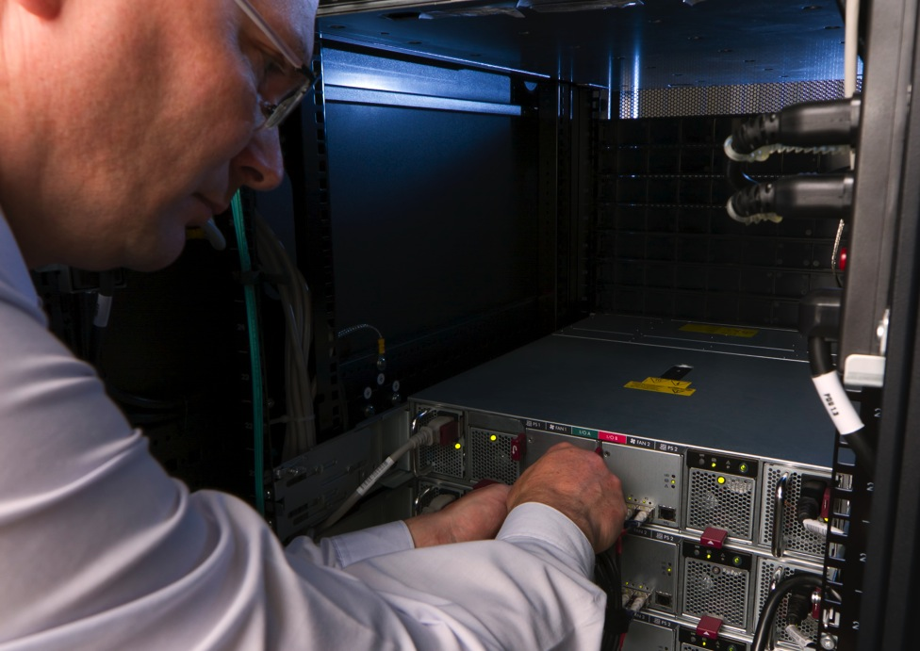


Did you picture someone like this?
Notes:
ASK: Did anyone see anything like this?
DO: Show the traditional pictures slowly. Watch for their reactions and pull out comments.

Slide 4





Or did you picture someone like this?
Notes:
ASK: Did anyone see anything like this?
DO: Show the progressive pictures slowly. Watch for their reactions and pull out comments.
DO: Watch their reactions. If they seem surprised by any of the pictures, stop and ask them about it.
ASK: Did any of these pictures surprise you? What surprised you about them?
KEY: IT is more than nerdy programmers. It is much broader than you may have thought and more fun. IT may be a place where you could have a great future doing what you love.

Slide 5
Did you picture someone like me?
Presenter picture goes here
Presenter quote
goes here
Name
Title, Company
Notes:
OPTIONAL: Insert your picture, job, title, and quote here.
ASK: Did anyone picture someone like me?
DO: Position yourself as one of the “positive, surprising” images of a person in technology.
DO: Tell a little of your story here. Focus on things like not starting in technology, blending technology with another interest/skill area, or working with people to start to wear down those stereotypes.
NOTE: If you like, you can also add your picture to the testimonial section and tell a longer version of your story there.
NOTE: After this slide would be a good point to show the video Consider Information Technology. It is a good overview/preview of the remainder of the presentation.
You will need access to the internet or will need to have the video file saved to your computer.

Slide 6
What is IT?
(Information Technology)
Notes:
Before we talk about having a great future in IT, we have to make sure we understand what information technology is.
DO: Raise your hand as you ask the question, which will model for the audience that this is what you want them to do.
ASK: How many people here think they have a really good understanding of information technology? Fairly good? A little? No clue?

Slide 7

What Is IT?
IT is the backbone of many things we take for granted day-in, day-out. IT is the engine that drives and supports businesses, industries, innovation and human communication.
IT impacts the way we live,
work, play and learn.
Notes:
DO: Review the slide and relate this to data systems with which they may be familiar.
DO: Raise your hand as you ask the question.
ASK: How many of you use YouTube, buy things online, play online games, or watch computer generated movies?
NOTE: This list may need to be adjusted based on the age of your audience.

Slide 8

IT Is Technical Tools
IT is tech hardware, software, the Internet, and the networks that tie
it all together
Notes:
DO: Review the slide and relate this to things they may own.
DO: Raise your hand as you ask the question.
ASK: Do you have a mobile, tablet or computer at home or school, microwave that has buttons and options, television that can connect to the internet?
NOTE: This list may need to be adjusted based on the age of your audience.
ASK: What other technology do you use?
DO: Listen for and reinforce excitement about technology devices.

Slide 9



IT Is People
IT isn’t just about the technology; it’s also about
the people you work with.
Notes:
DO: Pause on the opening picture.
ASK: How many of you like working with people?
KEY: We usually don’t think of IT as being people-focused, but in truth, a lot of IT is working with people.
DO: Show the people in IT pictures slowly.
ASK: Did any of these pictures surprise you? What surprised you about them?
KEY: IT is more than nerdy programmers. It is much broader than you may have thought and more fun. IT may be a place where you could have a great future doing what you love.

Slide 10

IT is the Future
IT is about
the future. Things are changing quickly, and IT is driving the change.
Notes:
This one will not surprise you. IT is the future. Things are changing all the time and most of these changes are brought about by technology.
ASK: What new technology inventions have you heard about?
ASK: What new technology inventions do you think will be coming soon?
DO: Listen for and reinforce excitement about technology.

Slide 11
IT has Jobs available
Notes:
DO: Raise your hand as you ask the question?
ASK: Does information technology seem more interesting now that when we first started talking?
KEY: When you think of your future, just keep in mind that IT might be a place where you fit better than you think. IT could be a place where you could have a great future doing what you love.
NOTE: This may need to be adjusted based on the age of your audience. Adults and older students may relate to the idea of career more than younger students.

Slide 12

Jobs Waiting to be Filled
90% of Chief Information Officers are challenged in hiring skilled IT professionals.
IT employment is predicted to grow at 2.19% a year – that’s five times faster than the UK average.
Source: Robert Half 2015 Salary Guide
Notes:
DO: Raise your hand as you ask this question.
ASK: Has anyone heard of the skills gap?
Skills gap refers to the idea that there are many job openings that are going unfilled because there aren’t enough people with the right skills.
KEY: IT is one of those areas that has a skills gap. There are many jobs available in IT, and the opportunities are growing.
NOTE: For a younger audience, this may need adjusting. They may be less interested in the skills gap and relate more to the idea that there are job openings in IT.
NOTE: The background information on the next set of slides provides more information should you want it. It is not intended as a script.
BACKGROUND: The total number of unfilled Information Communication Technology vacancies in the UK in June 2015 was approximately 37,000 – an 18.5% increase on the same period 12 months ago (according to UK Labour Market, June 2015, Statistical Bulletin. Office for National Statistics.
The Tech sector workforce makes up 5% of the entire UK workforce and employment of tech specialists is growing over four times faster than that for other UK professions. 134,000 new entrants a year are needed to fill tech specialist job roles in the UK, yet 42% of employers are struggling to fill tech specialist vacancies and only 16% of these specialists are women. (Source: The Tech Partnership, https://www.thetechpartnership.com/inspire/)

Slide 13
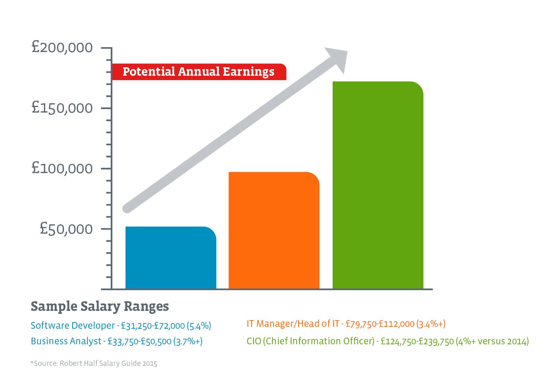
Jobs with Potential
Notes:
KEY: Not only are there jobs in IT, there are jobs where you can earn good money. It is estimated that IT jobs pay twice the average salary. For many IT careers, you can progress to more advanced positions as you gain more skills and experience.
BACKGROUND: CIO (Chief Information Officer) - £124,750-£239,750 (4%+ versus 2014); IT Manager/Head of IT - £79,750-£112,000 (3.4%+); Software Developer - £31,250-£72,000 (5.4%); Business Analyst - £33,750-£50,500 (3.7%+) – Source: Robert Half Salary Guide 2015

Slide 14
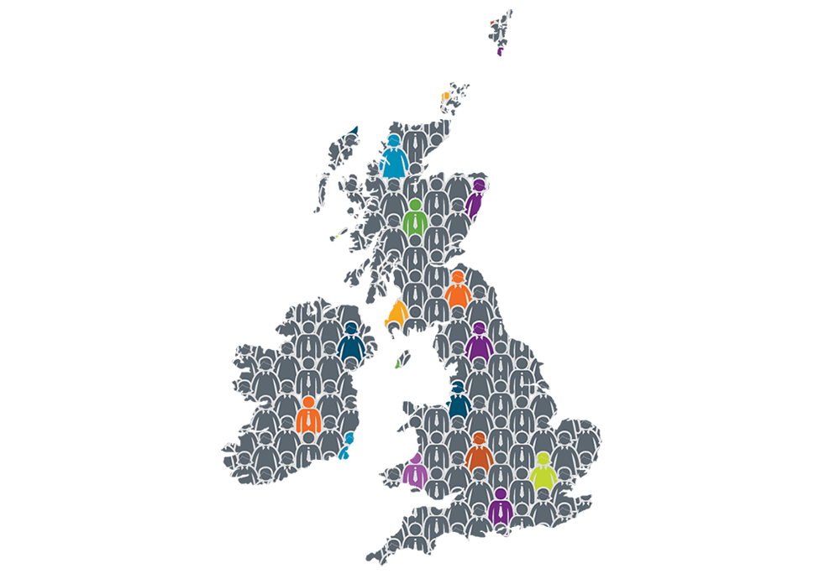
IT Needs More People
37,000 unfilled IT vacancies in UK in June 2015.
According to
UK Labour Market Statistical Bulletin, June 2015 (Office for National Statistics)
Notes:
KEY: IT is growing and needs more people! Everything we talked about-the number of openings, the ability to earn good money-- is not going away. In fact, it’s expanding. Once these 37,000 vacancies are filled the opportunities will not go away. The unfilled vacancies in June 2015 in the UK were 18.5% higher than the total in June 2014. As these jobs are filled, more and different IT opportunities will open up.
BACKGROUND:
There are numerous tracks and areas of study within the quite generic “IT field.” A career in IT offers something for everyone from programming/coding to business intelligence/analysis, troubleshooting to security, tech support to management, and so on.
BACKGROUND: The career offers lower unemployment (the number of unemployed people in Information Communication between Jan-Mar 2015 in the UK was 31,000 – a 36.7% decrease in the number of unemployed people in the industry compared to Jan-Mar 2014). Source: Unemployment by previous industrial sector, 13 May 2015. Office for National Statistics). This was the highest fall in unemployment levels across all 14 categories monitored by the ONS.
NOTE: After this slide would be a good place to show There’s a Place for you in IT video. This video shows young girls who do see themselves in IT futures and the benefits of this career direction for them.
You will need access to the internet or will need to have the video file saved to your computer.

Slide 15
There’s a Place for you in IT
Notes:
After everything we’ve just looked at about IT and about jobs in IT, I hope you are starting to see that there is a place for you in IT.

Slide 16

With a Career in IT you can...
Make a difference
Play with the latest toys
Work with technology and people
Earn good money
Work where and when you want
Do challenging work
Work in any industry
Consider Information Technology
Notes:
ASK: When you think of your [future] career, which of these are important to you?
DO: Listen for which of these they relate to. Reinforce their choices and energy.
NOTE: This list is based on research from NCWIT (National Center for Women & Information Technology) about factors that are important to women and girls as they consider career areas.

Slide 17

Do you like to…
Make discoveries
Learn how things work
Fix things
Solve puzzles and problems
Find faster, easier ways to do things
Be creative
Work with people
Consider Information Technology
Notes:
ASK: If you were to describe things you like to do, which of these might be included in things you like to do?
DO: Listen for which of these they relate to. Reinforce their choices and energy.

Slide 18

There’s a Place for You in IT
Start with your interests and strengths
+
Information Technology
=
Discover exciting career possibilities!
Notes:
KEY: IT might be more “your place” than you thought.
DO: Click to show the formula. Read the + sign as “add.” For example: “Start with your interests and strengths, add information technology, and you could discover exciting career possibilities.”
ASK: What are some of your interest areas?
DO: Keep their answers in mind as you may refer back to them in the next few slides.

Slide 19

There’s a Place for You in IT
If you like helping people
+ IT =
Health Informatics
User Experience Designer
IT Recruiter
Notes:
ASK: How many of you like helping people?
This is not generally an area that people think of when they think of technology.
DO: Watch for reactions. If they show interest or if someone mentioned this interest area in the discussion for slide 18, stop and ask them for their reactions to the ideas on the screen and for their ideas for careers in their interest plus technology.
NOTE: The background information on the next set of slides is there to provide more information should you want it. It is not intended as a script.
BACKGROUND:
Health informatics is one of the fastest growing areas in healthcare. In its most simplest terms, health informatics is about getting the right information to the right person at the right time. It is critical to the delivery of information to healthcare professionals so they can deliver the most appropriate care. You could be introducing electronic health records for every person in the country or exploring patient data to identify trends in disease and treatment. If you love working with computers or have an analytical and inquisitive mind, then there is a job for you in health informatics.
User Experience Designer studies how a user feels about systems and creates interactive products for web, mobile and game services with designs that are based on the needs and wants of the users. In designing a website, the user experience designer looks at traffic statistics to determine what types of experiences would be most effective for the audience.
IT Recruiter reviews job descriptions for technical roles and identifies and screens candidates for the positions. The IT recruiter needs to stay current with technology trends and understand the technical skills the company is looking for.

Slide 20

There’s a Place for You in IT
If you like art and music
+ IT =
Wearable Technology Designer
Web Developer
Computer Generated Imagery
Notes:
ASK: How many of you like art and music?
This is another of those areas where people don’t think of technology.
DO: Watch for reactions. If they show interest or if someone mentioned this interest area in the discussion for slide 18, stop and ask them for their reactions to the ideas on the screen and for their ideas for careers in their interest plus technology.
BACKGROUND:
Wearable Technology Designer weaves technology into everyday life with wearable products with widespread appeal. The earliest product designed in this field was the calculator watch from the 1980s. Today’s wearable technology designers are working to make technologies such as smartwatches and mainstream products like Google Glass.
Web Developer designs the layout and codes a website after establishing the site’s target audience and identifying the content it will host. The Web Developer tests the site to identify and resolve any technical problems.
Computer Generated Imagery Artist uses computer hardware and software to create still and moving images and visual effects. Computer generated imagery artists create the graphics used in art, printed media, video games, film and television.

Slide 21

There’s a Place for You in IT
If you like building and
fixing things
+ IT =
Environmental Engineer
Computer Hardware Engineer
IT Computer
Support Specialist
Notes:
ASK: How many of you like building and fixing things?
DO: Watch for reactions. If they show interest or if someone mentioned this interest area in the discussion for slide 18, stop and ask them for their reactions to the ideas on the screen and for their ideas for careers in their interest plus technology.
BACKGROUND:
Environmental Engineer solves environmental problems to improve recycling, waste disposal, public water, and water and air pollution control and to study our impact on natural ecosystems.
Computer Hardware Engineer designs new computer systems and components, including non-computer devices that use parts embedded with computer systems. Increasingly, computer hardware engineers are involved in designing medical supplies and car parts. The computer hardware engineer makes sure the hardware components work together with the latest software.
IT Computer Support Specialist helps users with computer hardware and software questions and troubleshoots network problems.

Slide 22

There’s a Place for You in IT
If you like selling ideas
and products
+ IT =
IT Marketing
Social Media Manager
IT Teacher or Trainer
Notes:
ASK: Do any of you like selling and teaching?
DO: Watch for reactions. If they show interest or if someone mentioned this interest area in the discussion for slide 18, stop and ask them for their reactions to the ideas on the screen and for their ideas for careers in their interest plus technology.
BACKGROUND:
IT Marketing blends the marketing team with technology to make the most of web and mobile apps, social media and interactive ads.
Social Media Manager is the voice of a business and interacts with its customers on social media sites. The social media manager engages the fans and builds relationships, which grows leads and sales.
IT Teacher or Trainer works in colleges, training companies and large corporations to teach a range of courses, from commonly used programs to programming and PC maintenance.

Slide 23
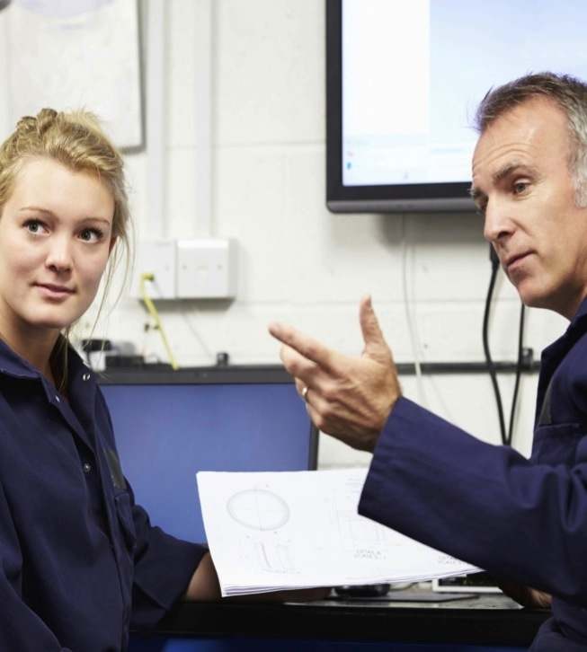
There’s a Place for You in IT
If you like
solving problems
+ IT =
Process Engineer
Search Engine
Optimisation
Computer Systems
Engineer
Notes:
ASK: How many of you like puzzles? Like to solve problems?
DO: Watch for reactions. If they show interest or if someone mentioned this interest area in the discussion for slide 18, stop and ask them for their reactions to the ideas on the screen and for their ideas for careers in their interest plus technology.
BACKGROUND:
Process Engineer evaluates a company’s manufacturing processes and makes improvements to reduce cost and improve sustainability.
Search Engine Optimiser follows a website’s performance and makes changes to improve page rank within search engines and maximise the traffic to the site.
Computer Systems Engineer builds and maintains a company’s computer system, keeping the user’s needs and expectations in mind.

Slide 24
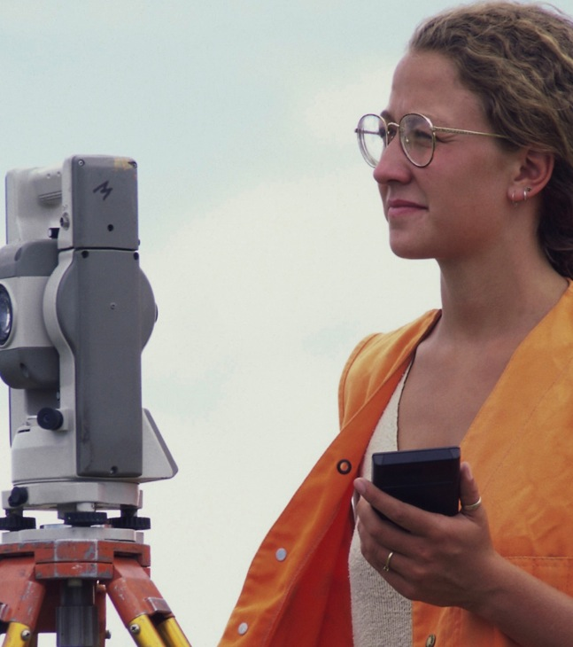
There’s a Place for You in IT
If you like working
with technology
+ IT =
Web or Application Developer
Video Game Designer
Computer Network Specialist
Notes:
ASK: How many of you like science and nature?
DO: Watch for reactions. If they show interest or if someone mentioned this interest area in the discussion for slide 18, stop and ask them for their reactions to the ideas on the screen and for their ideas for careers in their interest plus technology.
BACKGROUND:
Web and Applications Developer designs and creates websites and applications, writing new code and improving existing code. Web and applications developers find and fix bugs in programming code.
Video Game Designer imagines a game and then writes detailed descriptions of their ideas, including plot, characters and gameplay. During production, the video game designer works with programmers and artists to bring the idea to life.
Computer Network Specialist keeps a company’s networked computer system functioning and troubleshoots any connectivity problems.

Slide 25
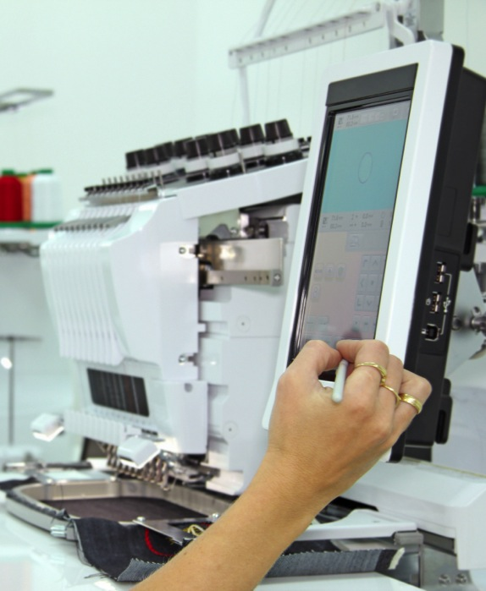
There’s a Place for You in IT
If you like
science and nature
+ IT =
Research Scientist
Geospatial Information Scientist
Sports Medicine
Notes:
ASK: How many of you like working with technology?
DO: Watch for reactions. If they show interest or if someone mentioned this interest area in the discussion for slide 18, stop and ask them for their reactions to the ideas on the screen and for their ideas for careers in their interest plus technology.
BACKGROUND:
Research Scientist plans and conducts laboratory experiments and gathers the results to make cause-and-effect connections. Research scientists can study and analyze anything from new product developments to medical breakthroughs in the health sector.
Geospatial Information Scientist uses software and tools such as geographic information systems and GPS to study and analyze how we use the space around us and how it changes over time. The results of a geospatial information scientist are used to make decisions as to the best place to build a school, hospital or bridge.
A job in Sports Medicine means you are working with patients to prevent and treat sports-related injuries, administering treatment to improve overall movement and performance.

Slide 26

There’s a Place for You in IT
If you like business
and leadership
+ IT =
Business Analyst
Project Manager
Chief Information Officer
Notes:
ASK: Who likes business and leadership?
DO: Watch for reactions. If they show interest or if someone mentioned this interest area in the discussion for slide 18, stop and ask them for their reactions to the ideas on the screen and for their ideas for careers in their interest plus technology.
ASK: Are you surprised by anything we just saw?
ASK: Are there other areas you are interested in? How might they be combined with technology?
BACKGROUND:
Business Analyst manages the way a company implements technology and determines the requirements of a project or program so that goals are met efficiently and cost-effectively. The business analyst is the link between a company’s IT capabilities and its business objectives.
Project Manager plans, budgets, oversees and documents all steps of a project for a company. The project manager works closely with upper management to make sure the direction of the project is on track with their expectations.
Chief Information Officer sits at the helm of the IT department and is responsible for the technological direction of the company. The chief information officer plans for a company’s technology needs and oversees the IT department, its projects and all programming.

Slide 27
Women in IT Stories
Notes:
I’m going to introduce you to some women who work in IT. Maybe one of them is doing work that someday you might be interested in doing.
NOTE: You may pick and choose from the testimonial slides based on what you think will interest your audience.
NOTE: The background information on the next set of slides is there to provide more information should you want it. It is not intended as a script.
DO: Watch for reactions as you go through the testimonials. Stop where they show interest.

Slide 28
Picture Yourself Here
Insert your quote here.
Insert your picture here.
Insert your name, title, company here.
Notes:
OPTIONAL: Insert your picture, job, title, and quote here.
DO: Tell the story of your career in IT.

Slide 29
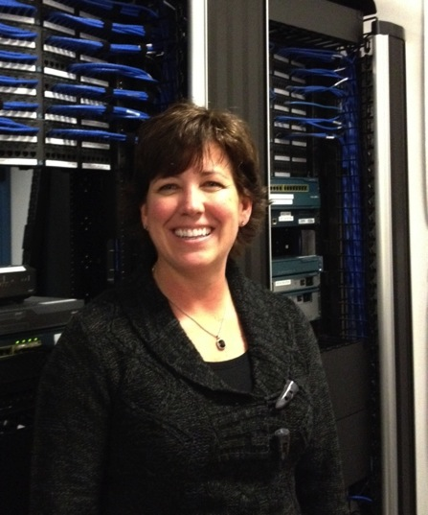
Picture Yourself Here
This is an exciting time for technologists as companies are now positioning their IT departments as strategic differentiators.
Shannon Moran
Director, IT Development
Brother International
Notes:
BACKGROUND: Shannon Moran, IT Development Director, Brother International
As the IT development director at Brother International, I oversee the operations for IT development and project management functions for our company. I formulate and deploy short- and long-term strategic plans for enabling efficient and cost-effective IT solutions across our U.S. and subsidiary offices. I also represent those offices when working with our global team.
I am continually amazed at the rate of change in our business due to advances in technology, specifically cloud computing, mobile and social areas. It is an exciting time for technologists, as companies now position their IT departments as strategic differentiators. All of that change means the sales and marketing teams are moving at the speed of light to meet the challenges in the market, and they demand an agile and forward-thinking IT organization. This presents many challenges that have an impact on resource planning and training, sourcing strategies and development technologies.

Slide 30
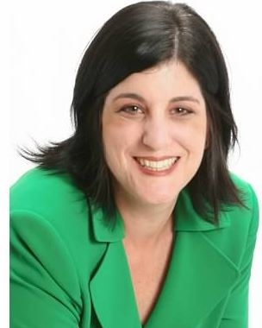
Picture Yourself Here
I have always enjoyed making technology come alive, creating an emotional connection with its users.
Rebecca Rosen
President
Sales Enabled
Notes:
BACKGROUND: Rebecca Rosen, President, Sales Enabled
As president of Sales Enabled in Los Angeles, I help technology companies improve the productivity, performance and results of their sales teams.
I started in IT two decades ago, first overseeing marketing communications and sales training for a midsized telecommunications company, where I had overarching responsibility for the company’s brand, customer acquisition and development strategies and sales training. During my tenure, I played a key role in helping drive the company’s growth from $20 million to over $550 million in annual revenues. I started my IT career at a boutique IT consultancy where I managed operations and training.
Having earned a master’s degree in the integration of choreography and technology, I have always enjoyed making technology come alive — creating an emotional connection with its users. Today, I love taking very complex products to market in ways that are extremely relevant and impactful to businesses.

Slide 31
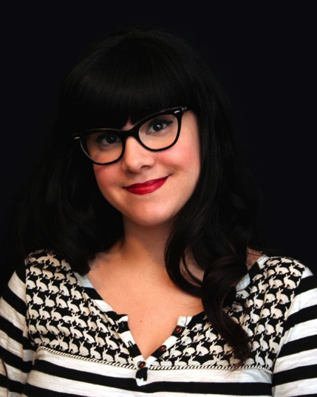
Picture Yourself Here
Social media is a fun and challenging field where I can use my psychology skills to create communities and effect change!
Angie Sheldon
Community Engagement Specialist | Betty Crocker Bisquick
Notes:
BACKGROUND: Angie Sheldon, Community Engagement Specialist, Betty Crocker and Bisques
When I got my master’s degree in counseling in 2009, my job barely existed. I moved forward with my degree, working in a psychiatric unit and then in a handful of nonprofit programs. When I realized that social media was a fun and challenging field where I could use my psychology skills to create communities and effect change, I simply started doing it — blogging, tweeting, you name it! I showed I was a good content creator and community builder and was hired by General Mills.
Today, I manage the social presence of Betty Crocker and Bisques in a cross-functional team. I am responsible for all strategy and execution, including campaigns, integrated marketing efforts and day-to-day interaction. The hardest part is that, as a very new field, my job is often misunderstood or not always valued, but I love being able to build and advocate for a community in a large company.

Slide 32
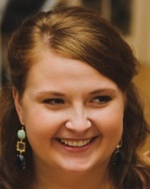
Picture Yourself Here
The way I think and the way I work with people have been the most important things I bring
to my job.
Grace Bredeson
Technical Consultant
Protiviti
Notes:
BACKGROUND: Grace Bredeson, Technical Consultant, Protiviti
I am a technical consultant for the midsize consulting company Protiviti, a subsidiary of Robert Half Technology. I work on projects for companies that have a business problem or want to implement a new system. It can be more efficient to those companies to bring in outside, experienced people instead of training employees or hiring new staff.
When I joined Protiviti, I didn’t have all the skills or know all the systems, but my company helped me learn along the way. The way I think and the way I work with people have been the most important things I bring to my job.
Variety is one of the best parts of consulting. I get to learn and work on different things, and no two days are ever the same. It’s a great way to experience different organizations, projects, industries, company cultures and even roles within a team. The variety is especially good for those in technology because the movement between companies and industries means they can work with and learn about all kinds of new technological innovations. Technical consulting has been a great career so far. I look forward to a fun and interesting future in it.

Slide 33
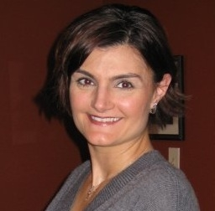
Picture Yourself Here
I was fascinated by computers in middle school and begged my Dad for a home computer.
Cristina Greysman
Director, Channel Program Management, SunGard Availability Services
Notes:
BACKGROUND: Cristina Martin Greysman, Director of Channel Program Management at Sungard Availability Services.
I’m the director of partner program management for Sungard Availability Services in Wayne, Pa., a technology services company. There, I help channel partners effectively sell our solutions to their customers.
I’ve worked business development and alliance management in the technology industry for 20 years. I was fascinated by computers in middle school and begged my dad for a home computer. Luckily, he obliged —though he wondered what I would use it for. My interest led me in the mid-90s to co-found Red Sector A, an Internet service provider and e-commerce website design firm. Early on, I saw that websites and the ability to transact business online was a game changer, especially for small business. I love the dynamism of the industry and how I am learning something new every day.

Slide 34
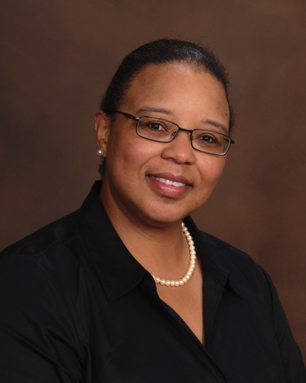
Picture Yourself Here
The diversity of the people and technical challenges
I encounter provide continuous opportunities for intellectual growth.
Robin Wright
Project Director, USA, Environmental
WSP
Notes:
BACKGROUND: Robin Wright, Project Director, WSP USA, Environmental
I manage teams and provide direct engineering and compliance support to global commercial and industrial clients. I work with multimedia environmental compliance and auditing, ISO 14001 auditing, environmental site assessments, site investigation and site remediation.
I like that no two projects or clients are the same. The technical challenges and diversity of the people I encounter are continuous opportunities for intellectual growth. I find it hugely satisfying to solve diverse technical problems and provide clients with beneficial alternatives.
Efficiently engineering solutions for global clients and locations requires heavy reliance on IT platforms, such as data management, communications and productivity tools. When there is a lack of access from remote locations, for example, or questionable stability of these platforms, my ability to do my job is limited. It’s beneficial for me to have direct contact with the IT department to resolve issues as they arise — and provide feedback to prevent new issues from cropping up.

Slide 35
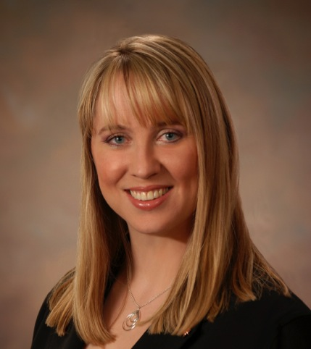
Picture Yourself Here
I look at technology as not just technical, but as a creative way to bring solutions and to change the world – one solution at a time
Cassandra Anderson
Director Channel Sales
Crexendo
Notes:
BACKGROUND: Cassandra Anderson, Director of Channel Sales, Chrexendo
I stumbled into the technology industry when I was working at an adolescent drug rehab center. We needed new phone and computer systems, and in working with the local phone installer I realized the technology fascinated me. The provider noticed and asked me to come on board as a customer trainer. I made the switch and after 18 years — and so many wonderful positions in the technology industry — I have never looked back.
I find the ever-changing world of technology fascinating. There are always new products and concepts to learn and share. I have the opportunity to help businesses improve and to make a difference. Women bring new perspectives to technology and business, and I encourage women to look at technology as not just technical, but as a creative way to bring solutions to individuals and companies and to change the world. We can make change — one solution at a time.

Slide 36
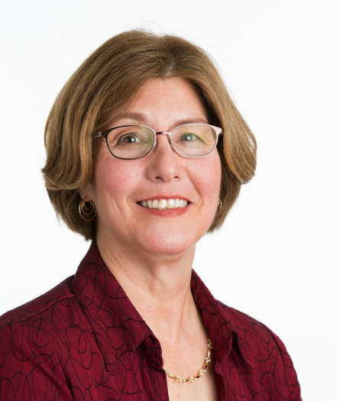
Picture Yourself Here
I enjoy traveling and meeting people from around the world, which allows me to learn and contribute on a vast array of subjects.
Doriana Allyn
Sr Manager, Environmental Health and Safety
Brother International
Notes:
BACKGROUND: Doriana Allyn, Environmental Health and Safety Senior Manager, Brother International Corp.
I am accountable on a daily basis for Brother International’s corporate-wide environmental, health and safety programs — including the company’s Environmental Management System ISO14001 certification for Brother Americas, which includes all Brother U.S. and Latin America locations. I participate in global environmental working groups in the creation of unified action plans.
I like meeting people from around the world. Traveling provides the opportunity to learn and contribute to a vast array of subjects related to both work and home.
Environmental laws change rapidly, and it’s a challenge to apply them to the company’s operations and already complex products. On top of that, I develop communication and trust between the company and the environmental function of our other locations and operations, which are in and outside of the United States. I participate in various relationship-building opportunities and add value to those served.

Slide 37
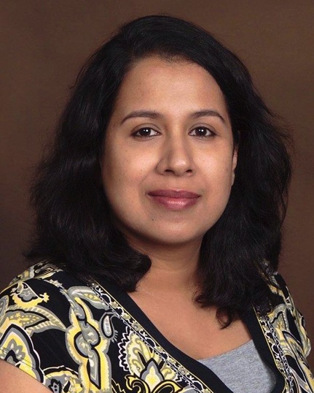
Picture Yourself Here
I chose science because I was naturally curious about things and I prefer to see results than be told about them.
Dr. Jayati Saha
Microbiologist
Notes:
BACKGROUND: Dr. Jayati Saha, Microbiologist
I was educated in India, where, between grades 10 and 11, I chose science as my main area of interest. I chose science because I was naturally curious about things, and I preferred to actually see results rather than be told about them. I work in a laboratory in a very clean environment and use computers to model and track my findings.
What I love about my work is that I get to think about a problem and experiment with ways to test a solution. It’s fun to see things work out. When experiments don’t work, I just start again with a different approach.
Girls and women make great scientists and technicians. Those who are curious, who want to do things by or for themselves, like to write, and are stubborn or tenacious can learn science and be very successful researchers. Science is a wonderful and satisfying career.

Slide 38
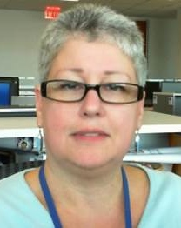
Picture Yourself Here
Part of my job is keeping the technical staff happy and not burnt out.
Lisa M. Yigdal
Manager, Helpdesk and Telecommunications
Brother International
Notes:
BACKGROUND: Lisa Yigdal, Helpdesk and Telecommunications Manager, Brother International Corp.
I am responsible for the management and administration of Brother International’s Helpdesk system, technicians and operations. In addition, I am also responsible for the company’s voice communications networks, systems and call centers.
I enjoy the daily challenges presented by our user community with regards to IT. I also enjoy being part of the rapidly changing IT landscape and learning new technologies.
Keeping up with our user community’s needs is an interesting balance. It can be a challenge to keep up with the continuous demand for helpdesk support while protecting my technical staff from burnout, but I enjoy it.

Slide 39
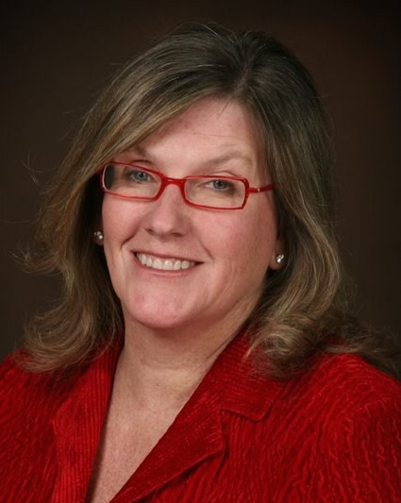
Picture Yourself Here
Working with the tools and the equipment was much easier than I’d thought, and the fixes were more like solving puzzles than getting into something dirty or scary.
Jean Mork Bredeson
Field Tech
GE
Notes:
BACKGROUND: Jean Mork Bredeson, President, Service 800, formerly Field Tech, GE
When GE offered me a field tech job, I was surprised. I hadn’t fixed computers before, but a quiz they gave me said I could do it. I took the job. When I went through their training, I was surprised again. Working with the tools and the equipment was much easier and cleaner than I’d thought, and the fixes were more like solving puzzles than getting into something dirty, heavy or dangerous. One of my managers told me that he wished all of his techs were women because they’re much more patient and accurate — and much better with customers.
I was a field tech for some time and soon I was a supervisor. The hands-on experience I had with the products and the interactions with the customers really helped me understand the business. I got more promotions and eventually started my own company, still working with break/fix and other services.
I often think how easy it would have been to not consider that first break/fix job. Once I learned that break/fix is more about understanding products and how people use them, taking a logical look at how to solve a problem and communicating well with customers, I was off on a career that I’ve loved.

Slide 40
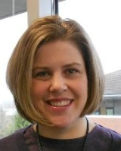
Picture Yourself Here
I got started in IT when I realized I LOVED technology
in high school.
Jody Shincke
IT Infrastructure Manager
REI (Recreational
Equipment Inc.)
Notes:
BACKGROUND: Jody Shincke, IT Infrastructure Manager, REI
I got started in IT when I realized I loved technology in high school. I started off the way a lot of women did 20 years ago: at a helpdesk. From there, my career took off. At the helpdesk, I got a good understanding of engineering, which eventually evolved into IT management.
Today, I manage five separate teams, varying from database and middleware technologies to client and retail technologies. It’s hard not always having enough time to dedicate to individuals, but the best part of the job is working with my teams on a daily basis and interacting with my peers. I enjoy helping them clear obstacles and assisting them in their career development, goals and objectives, especially when I can see them receive accolades and rewards for a job well done. Those moments are a huge source of pride.
So many people believe they’ll learn everything they need when they graduate college, only to find out that’s just the beginning. Have realistic expectations and take advantage of entry-level jobs that provide you with experience and knowledge — like a helpdesk.
There’s a perception that IT is a difficult field. While it’s not rocket science, it does have its challenges. IT provides a constant challenge that keeps you on your toes both mentally and professionally.

Slide 41
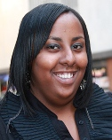
Picture Yourself Here
The Creating IT Futures IT Ready program helped me land a full-time technical support position.
Ngina BaGGett
Technical Support
Notes:
BACKGROUND: Ngina BaGGett, IT-Ready Graduate
I was having trouble getting entry-level work in the field. (IT-Ready) has really opened up a lot of doors for me. I had multiple job offers. Now I'm working on a help-desk for one of the top companies in the country. I finally moved out on my own, and in a couple years I'll be able to look for a house to buy.

Slide 42
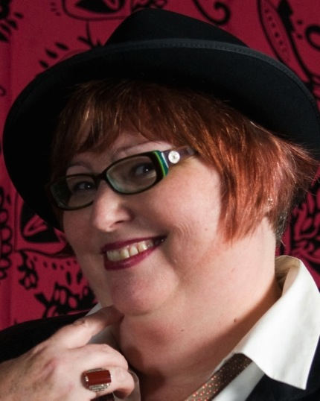
Picture Yourself Here
My ability to translate between my geek team members and the end-users sets me apart.
TC Culberson
Business Application Manager
NCPHS
Notes:
BACKGROUND: TC Culberson, Business Applications Manager, Northern California Presbyterian Homes and Services.
I am a double oddity in the geek world: a woman software developer with a degree in Asian history. My ability to translate between my geek team members and the end-users sets me apart and is a fundamental part of my career.
In administrative positions after college, I taught myself advanced word processing and database management, automating several offices before moving to coding when the opportunity arose.
After six years of implementing PeopleSoft as a road warrior for Fortune 500 companies, I took a job at Comcast, designing and implementing internal business use software, combining process automation, web portals and making complicated reporting requirements easy to read.
As a business applications manager, I’m in charge of all of the enterprise software for Northern California Presbyterian Homes and Services, a nonprofit that manages over $90 million annually to provide housing and services for the people we serve.

Slide 43
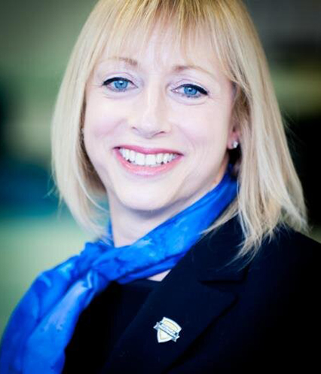
Picture Yourself Here
High-tech business to business marketing is a thrill. It’s ever-changing, requires constant learning and a passion for the industry.
Tracy Pound
Managing Director, Maximity, Birmingham
Notes:
BACKGROUND: Tracy Pound, Managing Director, MaximITy, Birmingham
I have over 30 years in the IT industry and have been voted one of the top 50 women in technology in a survey by PCR, the UK trade magazine for the computer and IT industry. My career has taken me through many industries successfully deploying large scale IT infrastructures ranging from £10k to in excess of £1.4m.
As a published author, I have also appeared on TV, most notably being featured with eminent UK inventor Sir Clive Sinclair. In April 2000 I was able to launch my own business, MaximITy, with the philosophy that IT should help facilitate business not hinder, and to translate business needs into technology solutions for businesses of all sizes.

Slide 44
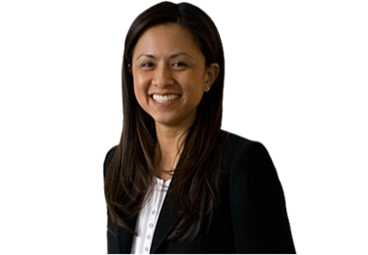
Picture Yourself Here
I work closely with the IT department so that all risk factors — legal and technical — can be considered when making business decisions.
Melody Culton
Senior Corporate Counsel
Brother International
Notes:
BACKGROUND: Melody Culton, Corporate Counsel, Brother International Corp.
As corporate counsel for Brother International, I provide all legal support for assigned business and operation divisions, including IT. I prepare, review and negotiate various contracts for such divisions, including contracts with IT distributors and resellers, plus service and product vendors, including SaaS. I research, advise and recommend actions to be taken to comply with applicable IT laws for such divisions, including environmental regulations and IT security standards.
I work closely with the company’s IT business and operations personnel to achieve efficient and effective resolutions to any legal or business IT issues that arise. All the projects that I work on are different, so nothing is routine. Sometimes the line between a legal issue and business issue is unclear, and it’s difficult to balance the risks. At these times, it’s helpful for me to have that relationship with IT because it helps me be a part of the IT business discussion so that all risk factors can be considered.

Slide 45
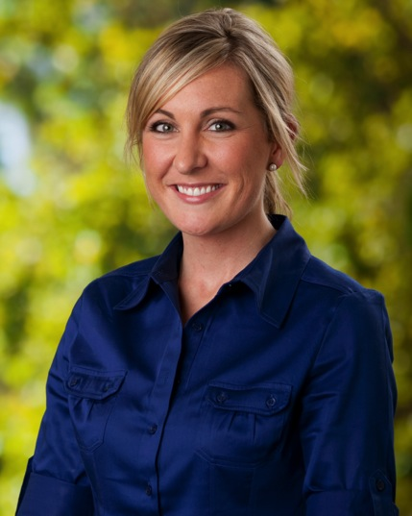
Picture Yourself Here
I love my job because I create processes and solutions to real problems — and I get to see the benefits for my company and our clients.
Jessi Norris
Project Manager
TekTegrity
Notes:
BACKGROUND: Jessi Norris, Project Manager, TekTegrity
As someone with a health care and service background, I did not have many technical skills to bring to the table at my first job interview. I did have great organizational skills, a strong work ethic and a desire to learn. As it turns out, that’s exactly what has made me successful.
I love my job because I can create processes and use them to find solutions to real problems — and get to see the benefits as they relate to my company and our clients. My advice to women interested in the IT industry: If you have tech skills, use them. It’s a no-brainer! If you don’t have the tech skills, don’t let that stop you. It’s a great field with something to offer everyone.

Slide 46
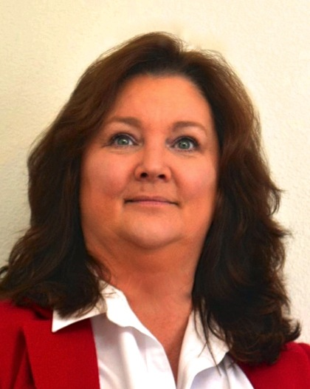
Picture Yourself Here
I am proud of advancing my career to the point where I can now influence system architecture and software applications
at HP.
Barbra Smith
Americas Business Operations Manager
Hewlett-Packard
Notes:
BACKGROUND: Barbra Smith, Americas Business Operations Manager for Care Packs, Hewlett-Packard
I moved into IT about 11 years ago, after starting my career at HP. I started in the quality assurance and testing of the system and architecture built for the HP Care Pack Services Business. My love of IT came early. I’ve spent years learning and advancing, and today I’m in a position to influence how system architecture and software applications are built.
I am proud of what I’ve been able to accomplish without a college degree, and I enjoy being able to mentor other individuals in the IT environment. I know, though, that potential further advancement would be easier with more education.
There are a lot of inexperienced people placed in IT roles today, and I have to train a lot of people who come in without any real-world experience. A degree goes hand-in-hand with real-world experience. Keep in mind that you might need to start in an entry-level position in order to gain the necessary basics skills.

Slide 47
Resources to help you get started
Notes:
ASK: Do you know more about IT now than you did at the beginning?
ASK: Did your ideas of IT change?
ASK: Did anything surprise you?
ASK: Could you see yourself in IT more now than before?
ASK: What kind of IT jobs or areas might be a good place for you given your interests and strengths?
Here are some ways to learn more about IT and IT careers.

Slide 48

In Our Local Community
  Add local resources related to IT careers to this slide.
  It might be local girl or women groups, schools, companies that offer programs, and so on.
  If you have no local resources, delete this slide.
Notes:
NOTE: This is a placeholder for the presenter to list any local resources.
NOTE: This might be a place to offer them access to a local group, non-profit organisation for girls or women, educational institution, or let them know they can call on you.

Slide 49

You can get started in IT at any age, anywhere, any time.
A university degree in IT is nice,
but not necessary.
Get started in 1-2-3:
Take some training classes online or in person
Get certified
Apply to work
Notes:
NOTE: This slide may be more appropriate for an older audience.
Not all IT jobs require a university degree. Certification is one way to get started in IT and can lead to other career opportunities.

Slide 50
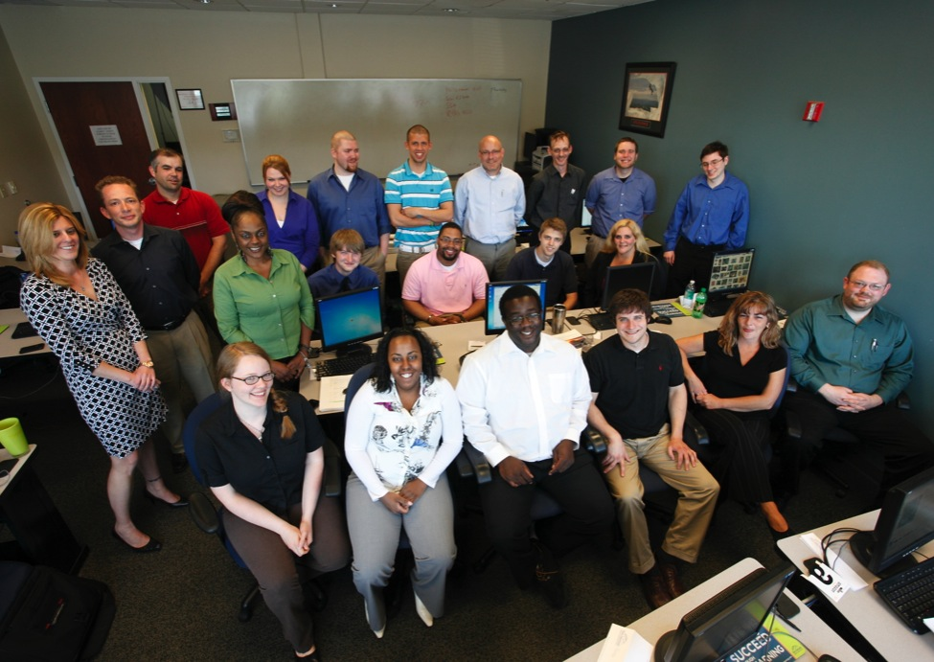
Additional Resources
Degree Apprenticeships.
Graduate Trainee Scheme.
Working to inspire young people about technology through a range of programmes and resources designed by schools and industry.
THE TECH PARTNERSHIP
www.thetechpartnership.com
Notes:
NOTE: This slide may be more appropriate for an older audience.
NOTE: The Tech Partnership
Degree Apprenticeships – help employers tailor the skills of fresh, emerging talent to their business need and offer young people opportunities to pursue academic learning alongside real-life work experience. The first degree apprenticeships will launch September 2015.
Graduate Trainee Scheme – a pilot between The Tech Partnership and local employers in East London to provide employers with the opportunity of taking on graduates at low cost, thanks to the generous support of J. P. Morgan. The programme gives companies an opportunity to enhance their teams with fresh talent, while helping computer science graduates accelerate their transition into work.

Slide 51
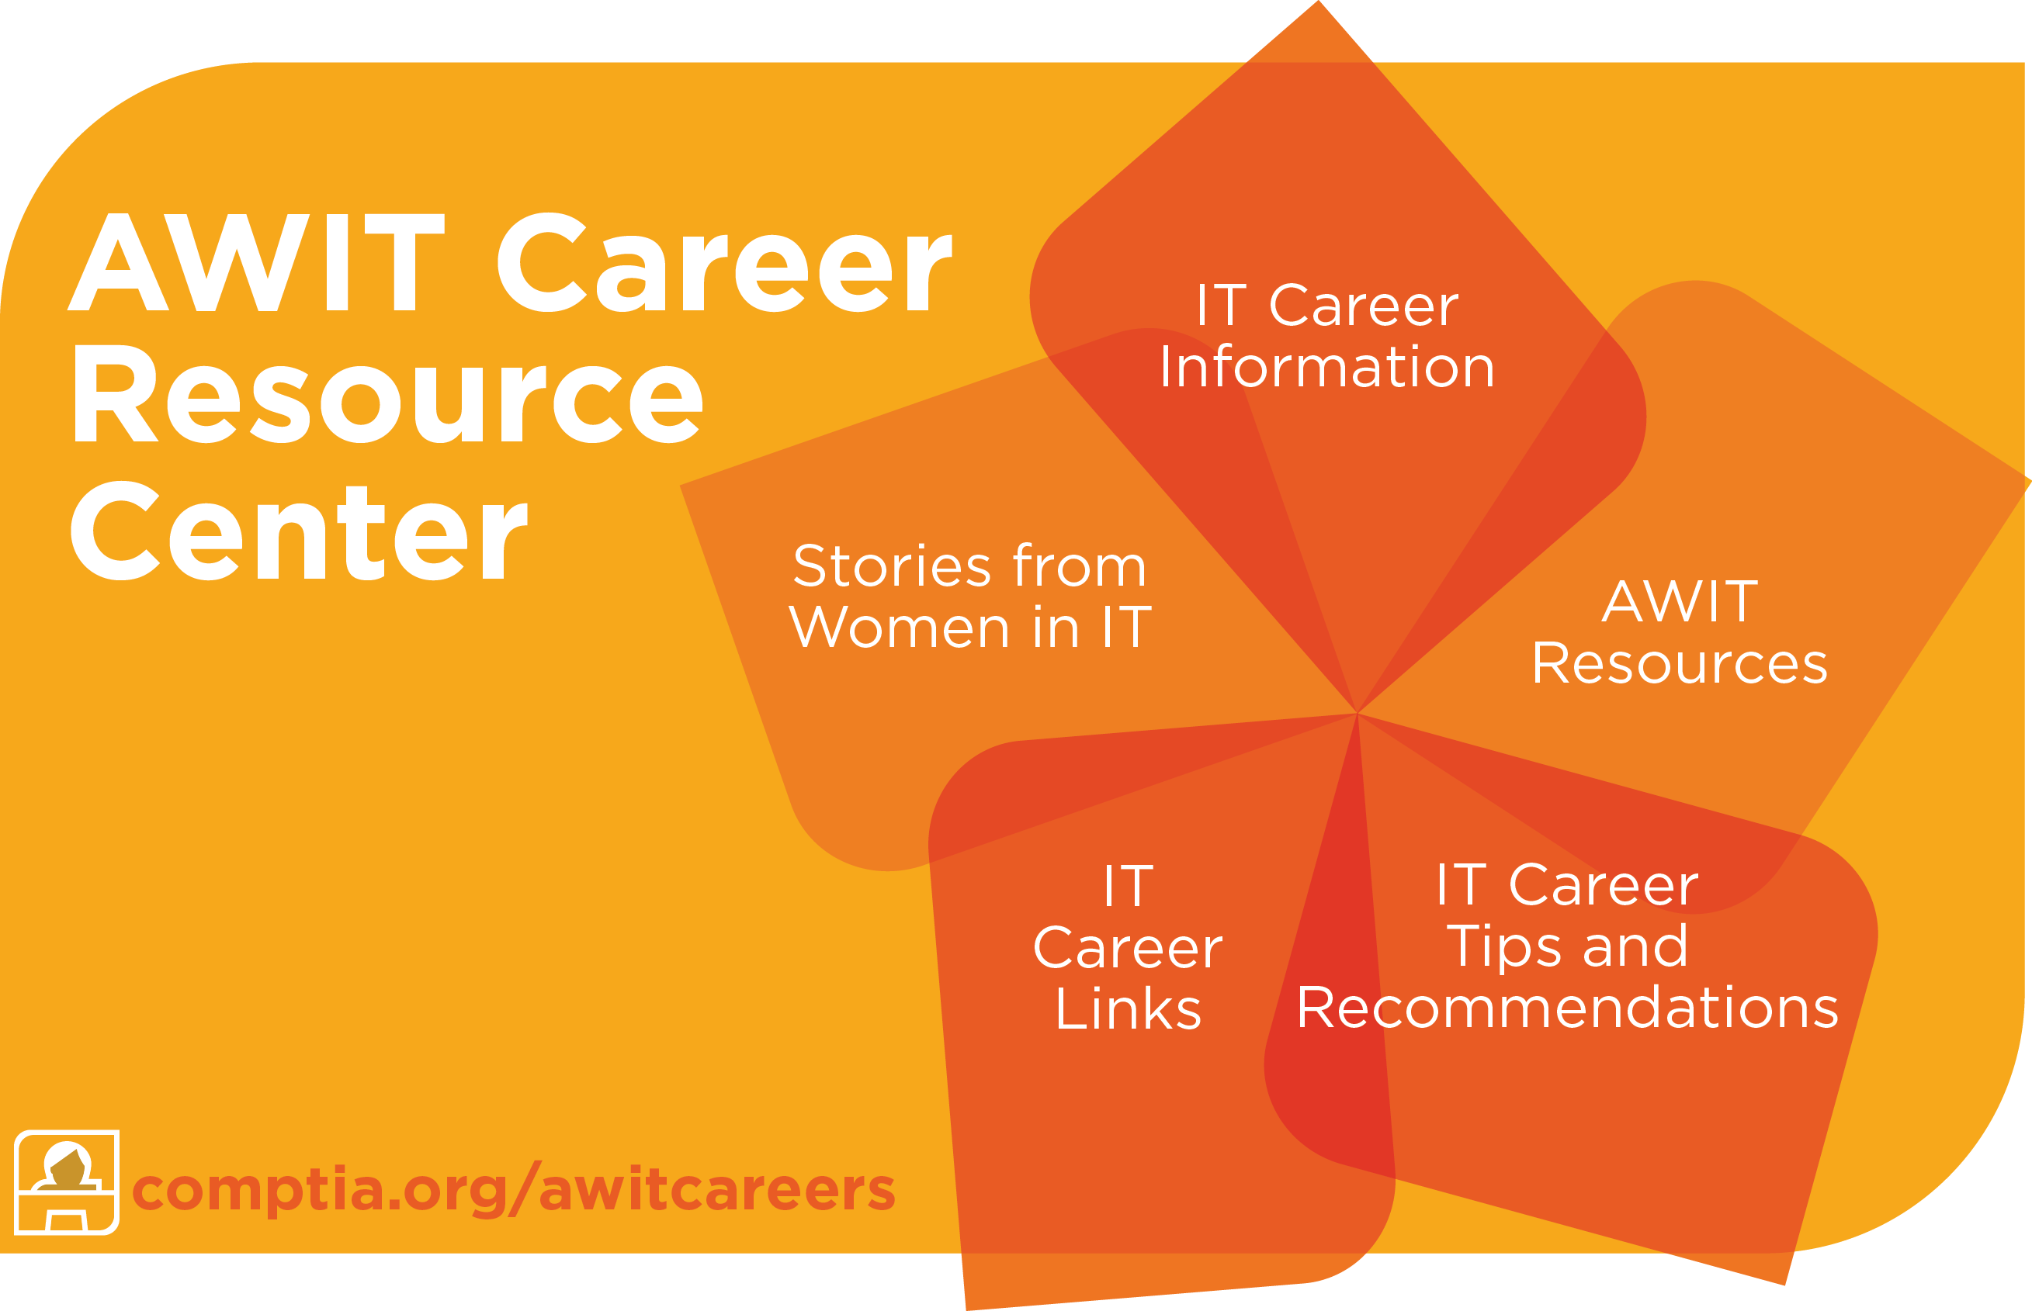
We are here to help
Notes:
KEY: The AWIT Career Resource Center (CRC) is the primary post-presentation resource for this program. It is open to anyone (female or male; students or adults) who wishes to learn more about IT careers.
NOTE: Based on the audience, you may wish to focus on different parts of the CRC.
BACKGROUND:
IT Career Areas
One of the benefits of information technology is that — whether you were born to write code or you work better managing a creative team — an IT career gives you loads of career options. Read about both core careers in IT — like database developers and chief security officers — and the nontraditional IT options in industries such as marketing and health care.
Career Testimonials
A career in IT doesn’t have to be stuffy or static. Many AWIT members hold interesting, flexible positions that keep them intellectually stimulated and involved in hands-on work. Through short testimonials, our members share their IT journeys and the pros and cons of their chosen fields. Read their stories here.
IT Career Tips
IT is a fast-paced field, and if you want to be a part of it, your career skills need to be on point. Learn to translate your skills into IT positions and sharpen your soft skills by following these tips.
IT Career Links
IT is growing, and groups around the nation and world are forming to give people the connections they need. Make your connections count with IT Career Links, covering everything from mentoring to STEM education.
AWIT Community Resources
CompTIA’s AWIT Community offers a wealth of resources from our members and beyond. Learn the ins and outs of IT through related videos and webinars, and connect with us through our AWIT social media channels.
DO: Point out the link at the bottom left of the screen.
ASK: Are there any questions. DO: Pass out the handout at this time.
DO: Point out the AWIT Facebook page that is listed on the handout.
Note: This would be a good place to demonstrate the AWIT Career Resource Center.
If you decide to show the website, you will need access to the internet.

Slide 52

Dream IT!
Let Yourself Dream of a Great Future
Imagine
Endless Possibilities
Notes:
NOTE: This is your capstone slide.
DO: Only show it after all questions have stopped
Thank you. I’ve enjoyed being here with you today. I hope that you have a better idea of what IT is all about and all the amazing career opportunities in IT.
And I hope that you can see that there is a place for you in IT.
DO: click to reveal the words “Dream IT” as you say them.
So along with [name of organization where you are presenting], I invite you to Dream IT.

Slide 53

Notes:
Thank you.

