Slide 1
Joint Industry Advisory Council Meeting
February 07, 2018

Slide 2
http://www.comptia.org/antitrust
CompTIA has a policy of strict compliance with federal and state antitrust laws. The antitrust laws prohibit competitors from engaging in actions that could result in an unreasonable restraint of trade. Consequently, you agree to avoid discussing certain topics in participating at any CompTIA events or activities, including, without limitation, any discussions relating to prices, fees, rates, profit margins, or other terms or conditions of sale (including allowances, credit terms, and warranties); allocation of markets or customers or division of territories; or refusals to deal with or boycotts of suppliers, customers or other third parties, or topics that may lead participants not to deal with a particular supplier, customer or third party.

Slide 3
Agenda
Welcome
Advisory Council Executive Board (ACEB) Update
New Advisory Council Members!
Mission and Objectives
March Dallas Meeting Agenda Review & Planning
CompTIA Departmental Updates
Open Discussion

Slide 4
Advisory Council Executive Board (ACEB) Update

Slide 5
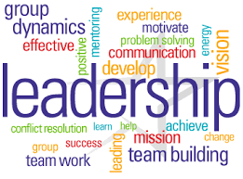
2018 Advisory Council Executive Board (ACEB)
CAB
Co-Chair - Steve Mungall - RedHat
Co-Chair - Ryan Walsh - Pax8
Vice-Chair - Chad Paalman - NuWave Technology
BAAC
Co-Chair - Rakesh Mahajan - Smartsheet
Co-Chair - Marc Haskelson - Compliancy Group
Vice-Chair - Taylor MacDonald - The Sage Group / Intacct Corporation

Slide 6
2018 Advisory Council Executive Board (ACEB)
DRAC
Co-Chair - Frank Segarra III - ConnexiCore
Co-Chair - Jon Tull - Dronifi
Vice Chair - Enrico Schaefer - Drone Law Pro
SCAC
Co-Chair - Robert Senatore - Data2Go Wireless
Co-Chair - Damian McCabe - Eseye
Vice-Chair - Tricia Shevlin - THINaër

Slide 7
Welcome new members

Slide 8
New Advisory Council Members!
Smart Cities Advisory Council
Peter Murray - Dense Networks
Robert Forget - Aware360
Thomas Ventulett - Aegex Technologies
Business Applications Advisory Council
Marc Monday - SAP (returning)
Kevin Layton - Data Dynamics
Darren Bibby - DocuSign
Nellie Scott – SaS

Slide 9
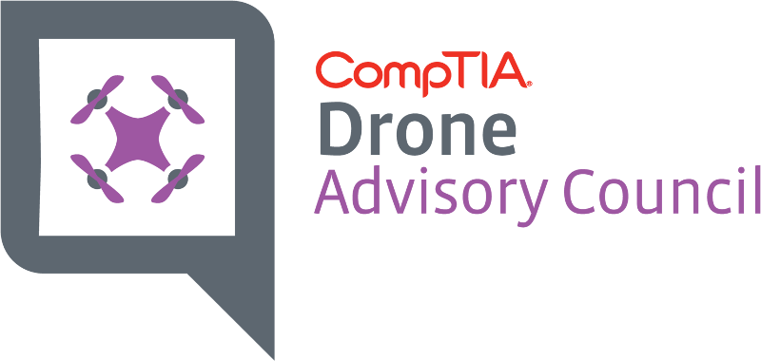
New Advisory Council Members!
Drone Advisory Council
Adam Gittins - HTS-Ag
Douglas Spotted Eagle - Sundance Media Group
Enrico Schaefer - Drone Law Pro (Vice Chair)
Frank Segarra III - ConnexiCore (Co-Chair)
Cory Dixon, PhD – University of Colorado, Boulder
Grant Goldsmith - Overwatch / Avalon Risk Mgmt
Robotics Advisory Council
Coming Spring 2019 (Fall 2018 Buildout)

Slide 10
Mission & Objectives

Slide 11
2018 Mission for CompTIA’s Industry Advisory Councils
Understand New Emerging Technology Ecosystems
Educate, Collaborate and Drive Adoption of Emerging Technologies into Mainstream Business
Stay informed on CompTIA’s Policy & Advocacy Efforts
Identify and Develop Industry Best Practice Standards

Slide 12
New Objective for this Evolution in Strategy
Expand
Expand CompTIA’s footprint and engagement with the broader ecosystem of business technology players
Enable
Enable the IT Channel to understand, adopt, and grow product and service portfolio’s with new and emerging technologies and partners
Educate
Educate emerging technology sectors on the value of the IT channel as a potential new route to market

Slide 13
Council Initiatives to Support the Mission
Over 1,000 Views!!
Thought Leadership Videos
Filmed During Face to Face Meetings
1-2 Minutes in Length
Podcast Series
10 minute “Coffee Break” sized Podcasts
Need volunteers
Featured Articles in CompTIA Magazine
Speaking Opportunities at CompTIA events, Community & Council Meetings, and AITP Local Chapters
Webinars & Training for CompTIA Staff
Interviews & Press Releases
Engagement on CompTIA Departmental Initiatives

Slide 14
March Dallas Meeting

Slide 15
Agenda for Spring “Working” Meeting
Tuesday, March 13th 2018, @ The Westin – DFW Airport, Dallas, TX
6:00 PM - Casual Networking Dinner @ Hotel
Wednesday, March 14th 2018
8:00 AM - Breakfast & CompTIA Update – Annette Taber
9:00 AM – Council Member Introductions – Chris Phillips
Share two areas of expertise & one area of interest
9:45 AM – CompTIA Policy Update – David Logsdon
10:15 AM – 2:00 PM - Councils Meet Independently over Lunch
2:00 PM – 5:00 PM – Council Synergistic Engagement Meetings
IT Channel & Business Applications
Drones & Smart Cities

Slide 16
Agenda for Dallas “Working” Meeting
Wednesday, March 14th 2018
5:00 – 6:00 PM – Freshen Up and Meet us at the Lobby Bar!
6:00 - 8:00 PM – Offsite Networking Dinner (TBD)
Thursday, March 15th 2018
8:00 – 9:00 AM – Networking Breakfast & CompTIA Updates
9:00 – 10:30 AM – Individual Council Meetings - Finalize Discussions & Build Report Out Slide Decks
10:45 – 12:00 PM – Industry Advisory Council Report Outs
12:00 – 1:45 PM – Lunch & Open Discussion
1:45 – 2:00 PM – Wrap Up and Close

Slide 17
Topics for Consideration

Slide 18
Channel Advisory Board (CAB)
Collaborate to Identify the Next Gen Influencers outside of the IT Channel Ecosystem (Digital Marketing Agencies, Certified Public Accountants, etc.)
Better Educate the IT Channel on Cloud Economics 101
Build Next Gen Partner Programs starting with “The Business Solution”
Advocate the IT Channel as a compelling route to market for Emerging Technologies, and adapt to new Processes Accordingly
Build “Solution Practices” around Emerging Technologies
Recruit, Hire, Train and Retain Competent, Skilled Staff Members

Slide 19
Business Applications Advisory Council (BAAC)
Drive Awareness of CompTIA and the IT Channel to Business Application and SaaS Application Providers and Resellers
Educate on the Benefits of Using the IT Channel as a route to market
Open New Markets, Lower Acquisition Costs
Drive Increased Usage of CompTIA Content
Understand Needed Changes in Marketing Approach to Bring IT Channel and Emerging Technologies together
Identify “Profile Persona’s” of Biz App Buyer & Purchase Decisions
Identify & Explain “Standards” of SaaS/Biz App Partner Programs
Type of Programs, When Used, How the Channel Partner Adds Value
Partner with Line of Business Tech Associations on IT Channel 101

Slide 20
Drone Advisory Council (DRAC)
“Data is obviously the foundation of an insights economy, but similar to other raw materials, it requires refinement and conversion into something of value.”
Taming the Wild, Wild West with a focus on Pilots & Professionalism.
Work with the Drone Industry (AUVSI, & others)
to identify professional best practice standards for Flight Service Providers
to identify Data Standards that allow the sensors, drones and maps to all communicate
to assess the need for an updated Commercial Drone Pilot Certification

Slide 21
Smart Cities Advisory Council (SCAC)
“The relatively low cost of IOT devices is not reflected in the cost of system maintenance and optimization.”
“…new skills are needed for the different types of data streams being generated and the advanced analysis that companies want to perform.”
“Automation will certainly help ease these burdens, but IOT strategies will still further complicate the already-difficult redefinition of the IT function.”
“AI requires…contextual awareness (which can come from IOT devices or massive collections of data)” …. and “… the skills to manage AI components so they are not just dealing with mysterious black boxes producing unexplained output.”

Slide 22
Comptia Departmental updates

Slide 23
CompTIA Department Updates - Policy
David Logsdon, Sr. Director Public Sector, Federal Civil Public
Will be our Council Liaison to CompTIA’s Public Policy and Advocacy team
Dallas update on various legislation including the “Chance in Tech Act”, Cybersecurity, Workforce, Smart Cities, and Drones
Liaison to Smart Cities and Drone Council
CompTIA’s DC Fly-In / February 13 & 14th
Tech Policy Summit
Tech Champion Award Dinner
Capitol Hill Speakers Series
Capitol Hill Visits
Chris Phillips will be there, will you?
CompTIA’s Advocacy Council on Policy (one rep from each council)

Slide 24
CompTIA Department Updates - Education
Sales Quick Start Guide for ISV’s
QSG to IoT
QSG to Profitable Partnering
QSG to Sales for Tech Teams
Templates for ISV’s
Job aids, checklists, and more for ISVs for customer acquisition and onboarding.
SaaS Transition Toolkit
To help an ISV owner train internal staff
Employee- level concerns

Slide 25
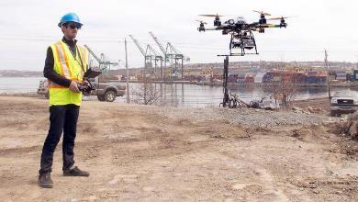
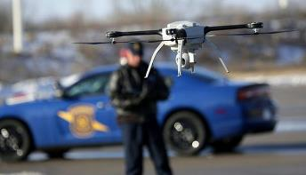
CompTIA Department Updates - Education
Drone Standards / Certifications
Ensuring high quality Data Standards
Identifying best practices for Data Collection
Best Practices for Flight Service Providers
What it means to be a Professional Pilot
How to interact with customers
Flying best practices

Slide 26
CompTIA Department Updates - Communities
Emerging Technologies Community
Building Framework to Evaluate & Rank Emerging Technologies
Publish as an Annual Outlook Report
Margin & Business Opportunity, Restrictions, Dependencies
Potential Collaboration between Community and Industry Advisory Councils
Validate Findings
Share Case Studies
Speaking Engagements
Webinars
Panels
Videos

Slide 27
CompTIA Department Updates - Research
Annual Council Survey*
Emerging Tech Series: AV/AR, Automation, Government, Placeholder (Drones, etc.)
Workforce, Generational Issues, Youth Opinions, Diversity Issues
IT Industry Outlook
Cloud / IT Architecture
Tech Trade Snapshot
Apprenticeship Study
Quarterly IT Business Confidence Index*
Operational Models/Efficiency (SPs, MSPs)
CyberStates (and Cities)
State of the Tech Ecosystem
Monthly IT Employment Tracker
Cybersecurity

Slide 28
new Council website!

Slide 29
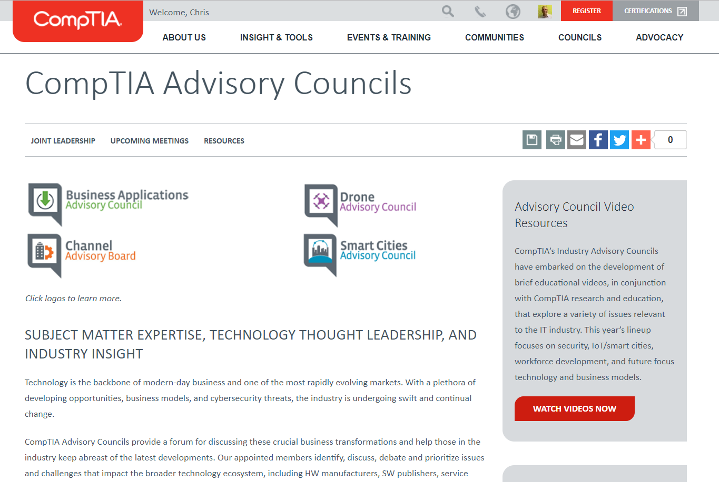
Awesome New Website!!!
Your One-Stop Shop for All Council Needs!
Councils get home page real-estate!
All resources located in one place, on main page!
Dedicated Video and Podcast area!
Individual pages to showcase council activities and updates!

Slide 30
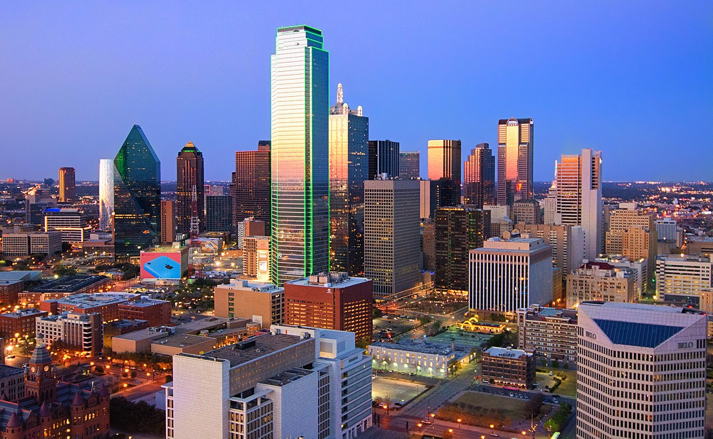
Open Discussion
REMINDERS:
Council Survey
DC Fly-in 2/13-14
Book Dallas Hotel!
Spring Working Meeting 3/13-15
Next Call: April 25th @ 1PM ET
Update Profile in Speaker’s Bureau

Slide 31
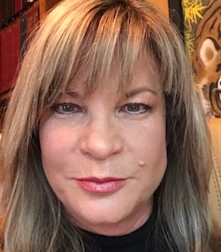
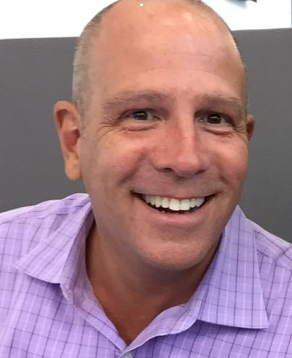
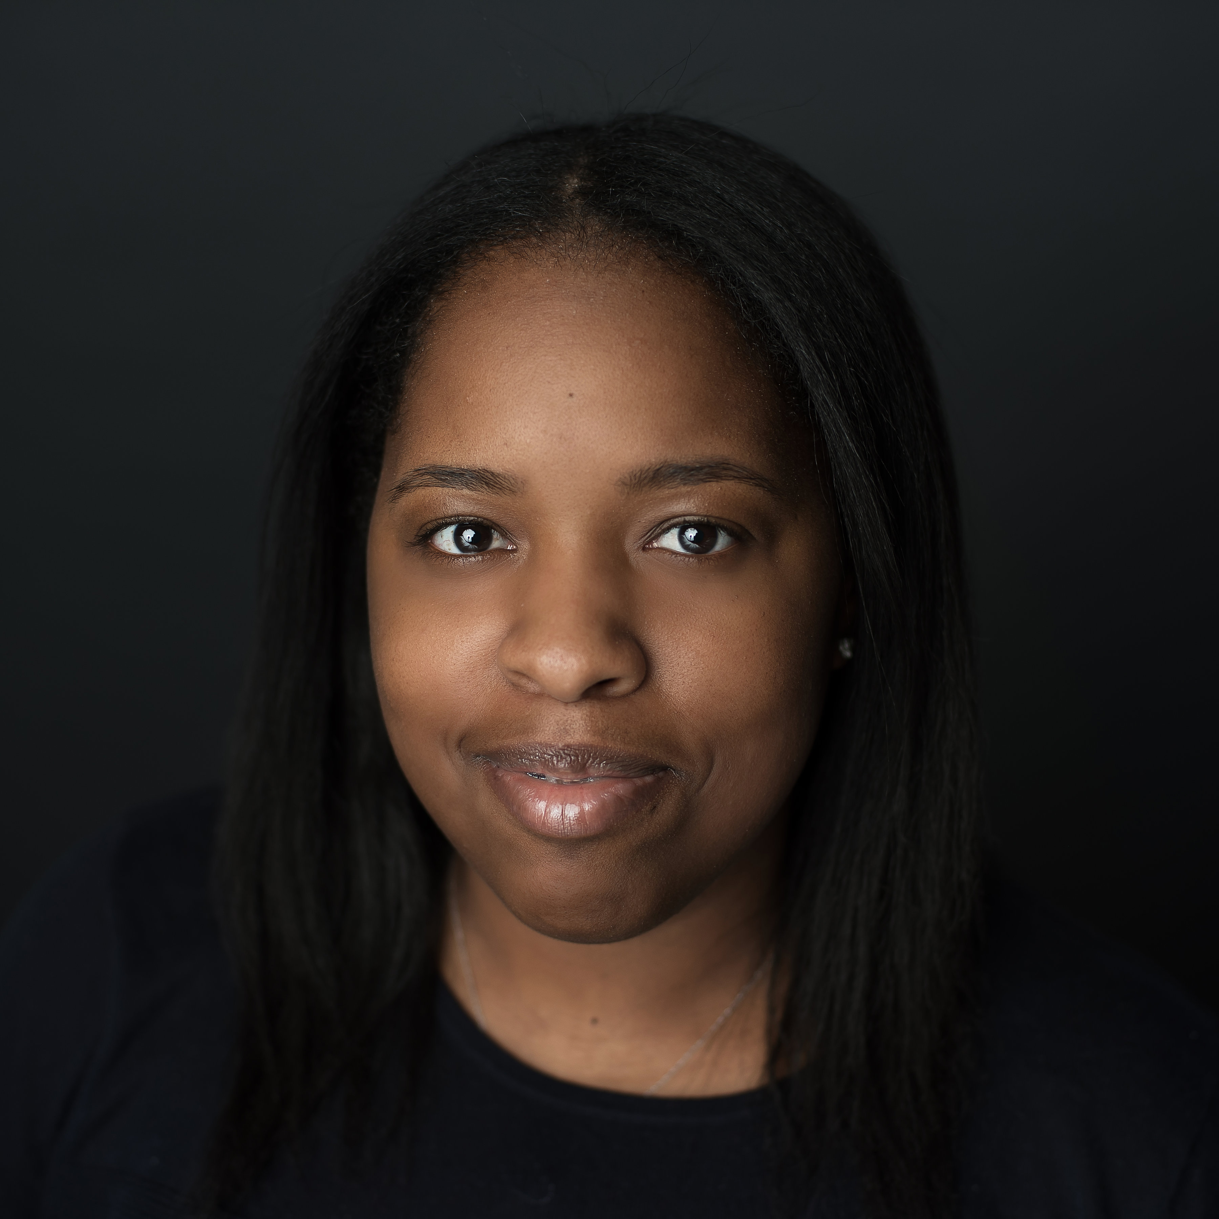
Annette Taber
Vice President, Industry Outreach
Email: ataber@comptia.org
Mobile: 727-244-1059
Office: 630-678-8515
Chris Phillips
Director Industry Advisory Councils
Email: cphillips@comptia.org
Mobile: 949-397-7102
Office: 630-678-8417
Kimaya “Maya” Wentworth
Specialist, Industry Relations
Email: kwentworth@comptia.org
Mobile: 630-750-4390
Office: 630-678-8328

